Slide 1

VETRI VINAYAHA COLLEGE OF ENGINEERING AND TECHNOLOGY
ANNA UNIVERSITY : CHENNAI OCT 2023

Slide 2
SUBMITTED BY
KARTHIKETAN B 623320104012
JAGAN S 623320104010
UDHAYA U 623320104025
SANTHOSHKUMAR P 623320104019
Guided by
Mr.SURIYA
AP/CSE

Slide 3
PROJECT TITLE
CENTRAL BANKING SMART CONTRACT

Slide 4
INTRODUCTION
A central bank smart contract is a self-executing contract with the terms of the agreement directly written into code.
In the context of a central bank, this could refer to a smart contract governing various financial and monetary operations.
For instance, a central bank smart contract might be designed to automate certain aspects of monetary policy, such as adjusting interest rates based on predefined economic indicators.
It could also be used for issuing and managing digital currencies, facilitating secure and transparent transactions within the financial system.
It's a fascinating intersection of traditional finance and cutting-edge technology

Slide 5
EXISTING SYSTEM
Digital Currency Issuance: Central banks could create digital currencies as smart contracts, providing a more efficient and transparent way to issue and manage currency.
Monetary Policy Execution: Smart contracts could automate the execution of monetary policies. For instance, adjusting interest rates based on predefined economic indicators or automatically implementing quantitative easing measures.
Transaction Settlement: Smart contracts could facilitate faster and more secure settlement of transactions between financial institutions, reducing counterparty risks.

Slide 6
EXISTING SYSTEM DISADVANTAGES
Security Concerns: Smart contracts, like any code, are susceptible to vulnerabilities. Bugs or security loopholes in the code could lead to exploits and financial losses.
Legal and Regulatory Challenges: The legal status of smart contracts and their adherence to existing financial regulations can be uncertain.
Dependency on Technology: Smart contracts are reliant on technology infrastructure, and any disruptions or failures in the underlying technology (e.g., blockchain networks) could impact the functioning of these contracts.
Resistance to Change: The financial industry is traditionally conservative and resistant to rapid change

Slide 7
PROPOSED SYSTEM
Digital Currency Issuance:
Central banks could issue digital currencies as programmable tokens through smart contracts, allowing for precise control over monetary supply.
Programmable Monetary Policy:
Smart contracts could automate the execution of monetary policies based on predefined conditions. For example, adjusting interest rates or liquidity measures in response to economic indicators.
Transparent and Auditable Transactions:
All transactions could be recorded on a blockchain, providing a transparent and immutable ledger. This transparency could enhance accountability and facilitate audits.

Slide 8
PROPOSED SYSTEM ADVANTAGES
Efficiency: Sicker execution of transactions, policy implementations, and overall decision-making, streamlining the functioning of the central bank.
Transparency: The decentralized nature of blockchain ensures transparency. All transactions and policy implementations are recorded on a public ledger, providing a clear and auditable history.
Reduced Fraud: Smart contracts operate on secure blockchain technology, making it resistant to tampering.
Cost Savings: Automation through smart contracts can lead to cost savings by eliminating the need for intermediaries, reducing paperwork, and increasing overall operational efficiency.

Slide 9
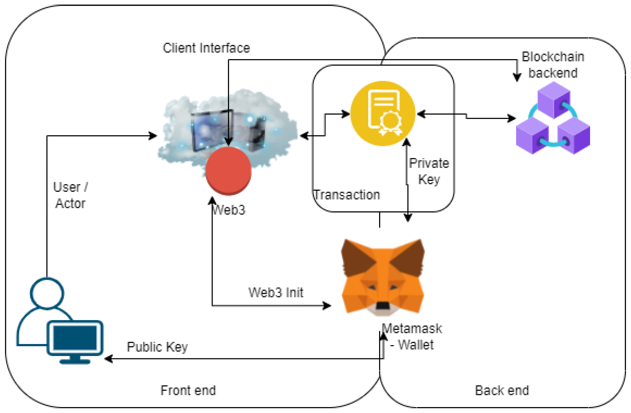
SOLUTION ARCHITECTURE

Slide 10
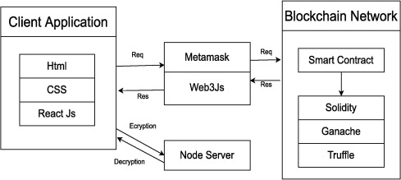
FLOW DIAGRAM
RREMIX IDE

Slide 11
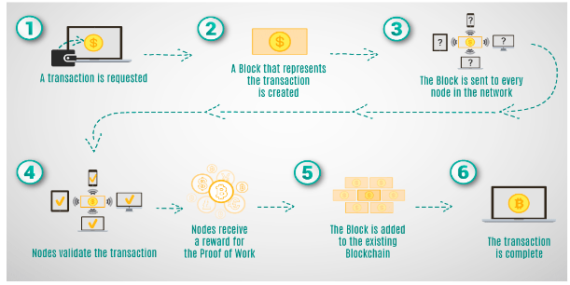
TECHNICAL ARCHITECTURE

Slide 12
CONCLUSION
In conclusion, integrating smart contracts into the functions of central banks presents a promising vision for the future of monetary systems.
The automation, transparency, and efficiency offered by smart contracts could revolutionize the way central banks operate.
Digital currency issuance, automated monetary policy execution, secure transaction settlements, regulatory compliance, data transparency, and streamlined cross-border transactions are among the potential benefits.
However, this transition is not without its challenges. Security concerns, scalability issues, and the need for a robust legal and regulatory framework are significant hurdles that must be overcome.

Slide 13
FUTURE SCOPE
Central Bank Digital Currencies (CBDCs): Many central banks are exploring or actively developing CBDCs. Smart contracts could be integral to the design and operation of CBDCs, enabling programmable money and automating certain monetary policies.
Tokenization of Assets: Central banks might tokenize traditional assets (such as government bonds) using smart contracts, making these assets more accessible and facilitating faster and more efficient trading on blockchain platforms.
Automated Monetary Policy: Smart contracts could play a crucial role in automating various aspects of monetary policy, such as adjusting interest rates based on predefined economic indicators or automatically executing quantitative easing measures.

Slide 14
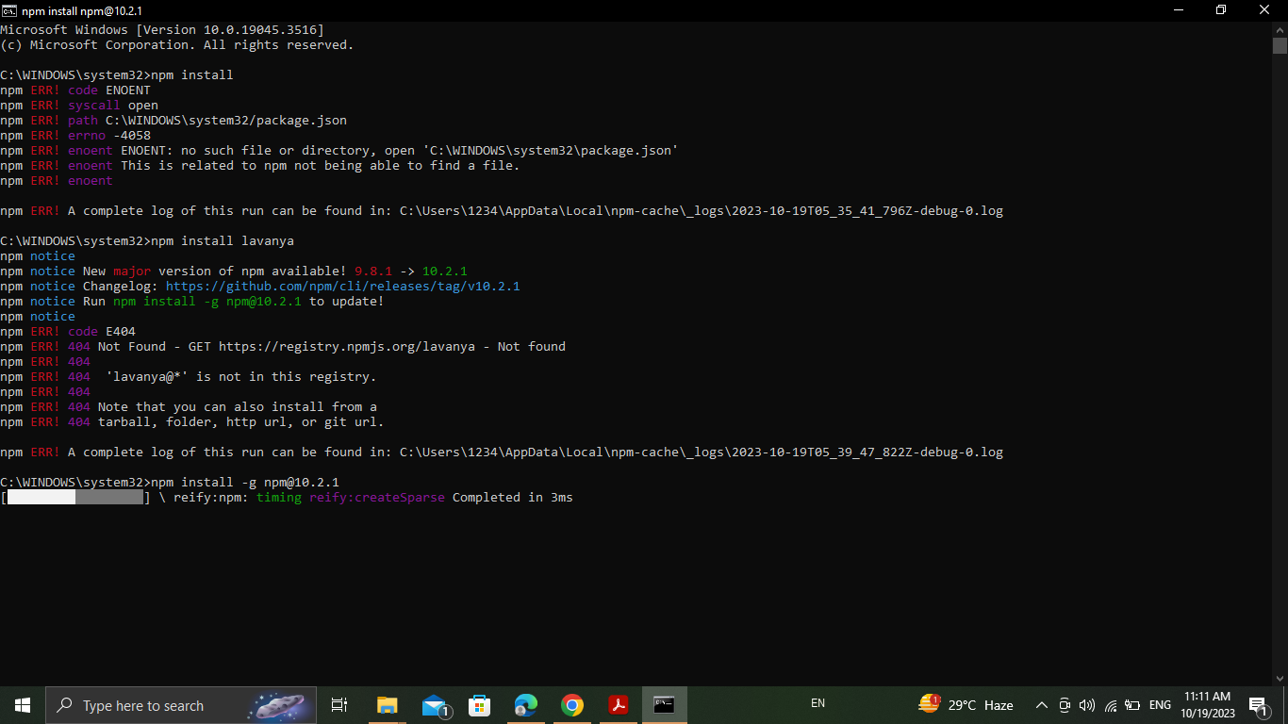
OUTPUT

Slide 15
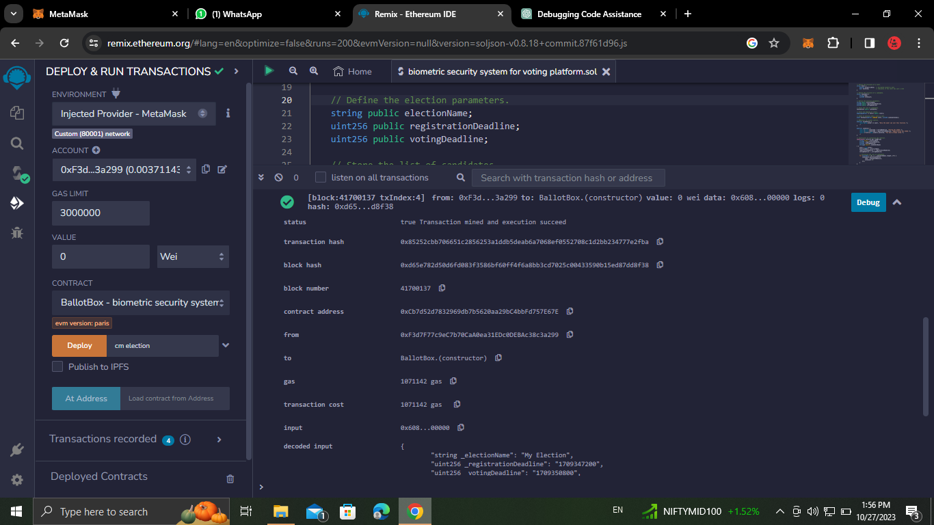

Slide 16
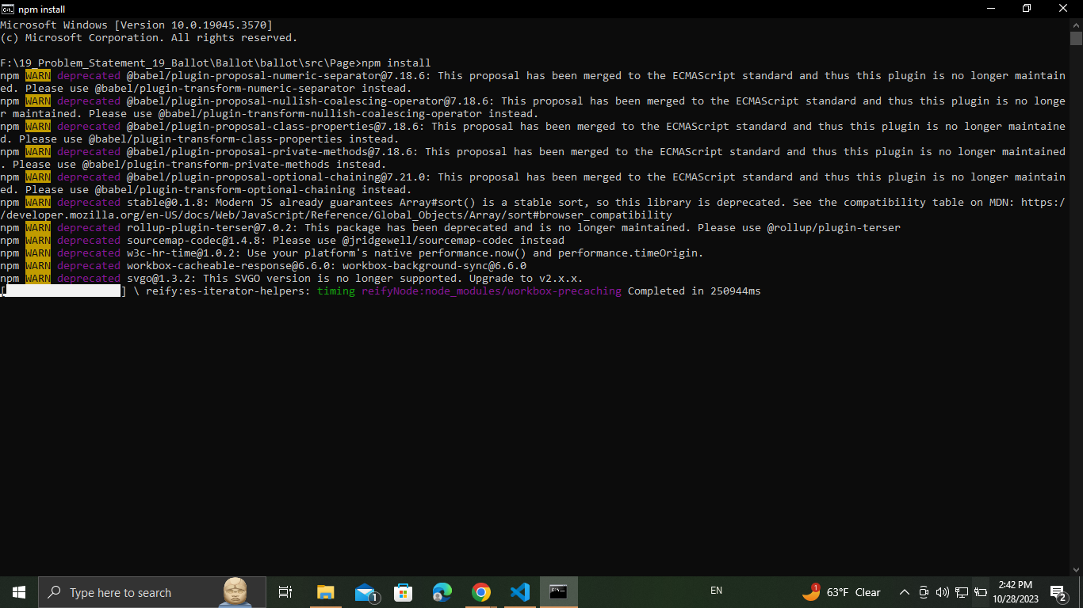

Slide 17
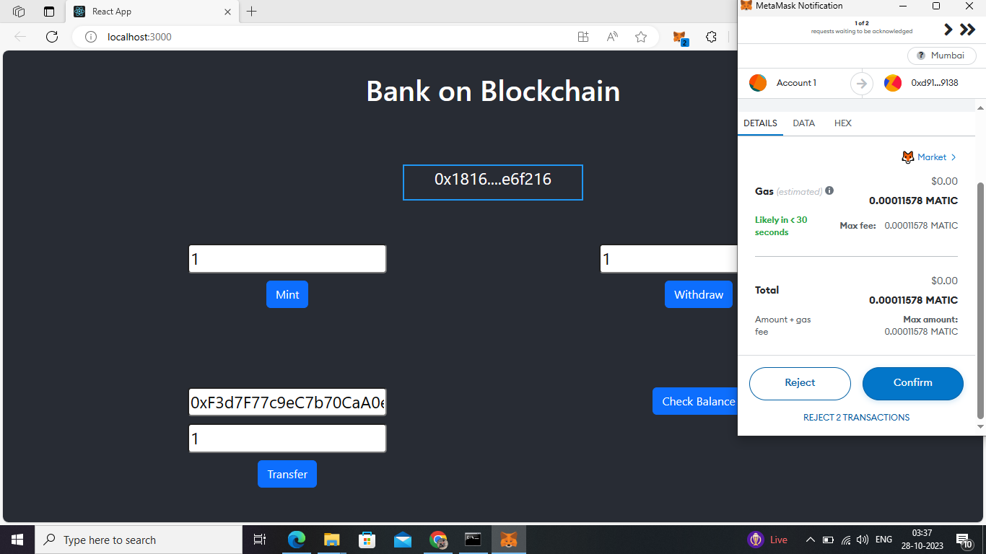

Slide 18
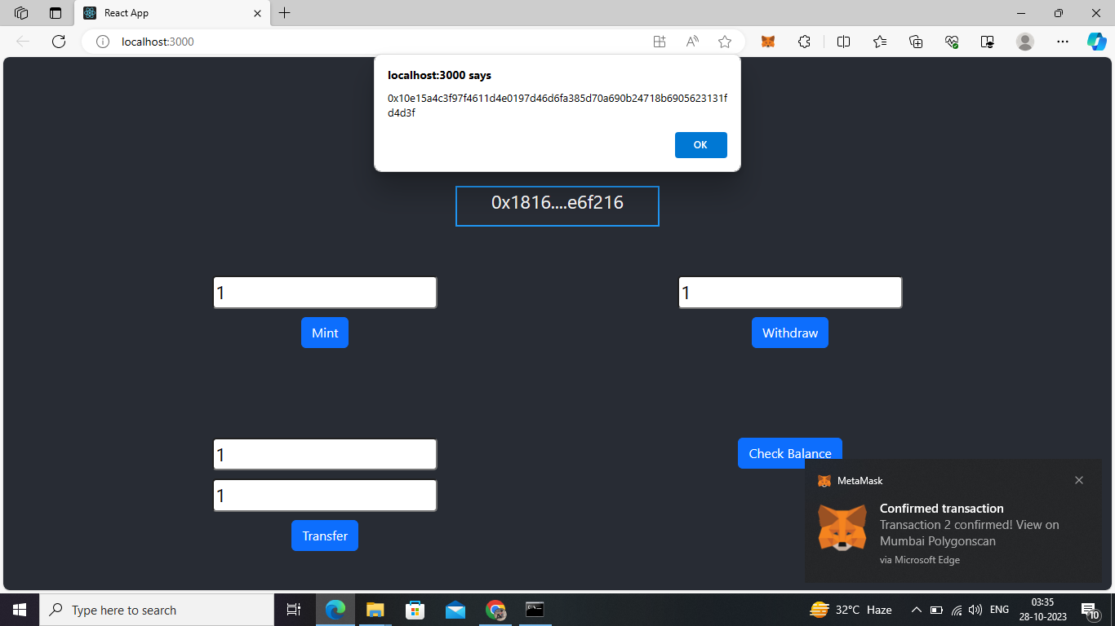

Slide 19
THANK YOU

